Slide 1


Slide 2
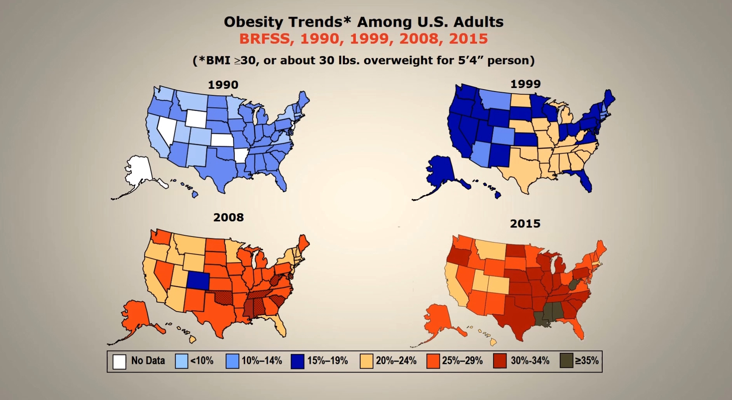


Slide 3
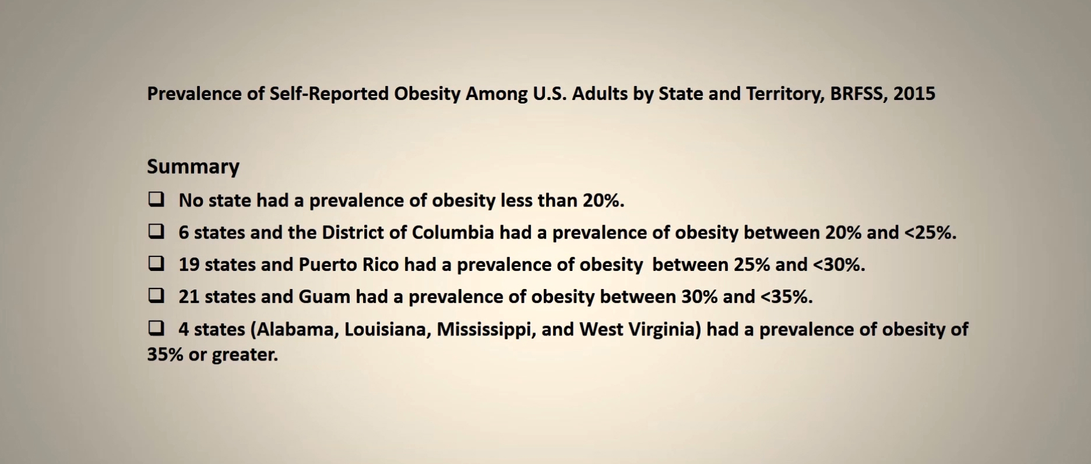

Slide 4
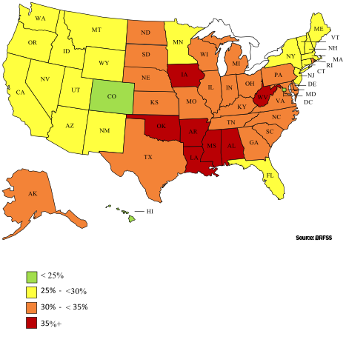
Adult Obesity Rates by State, 2017
In addition, new state level data from the CDC’s 2017 Behavioral Risk Factor Surveillance Survey (BRFSS) show that adult obesity rates rose by statistically significant amounts in six states and no states experienced a reduction in rates of obesity.

Slide 5
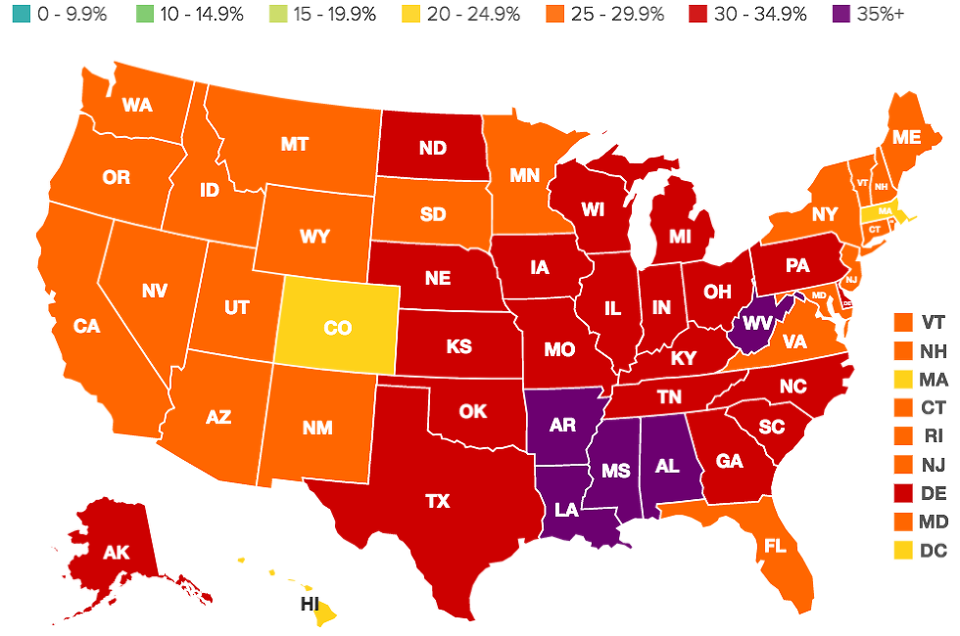

Slide 6
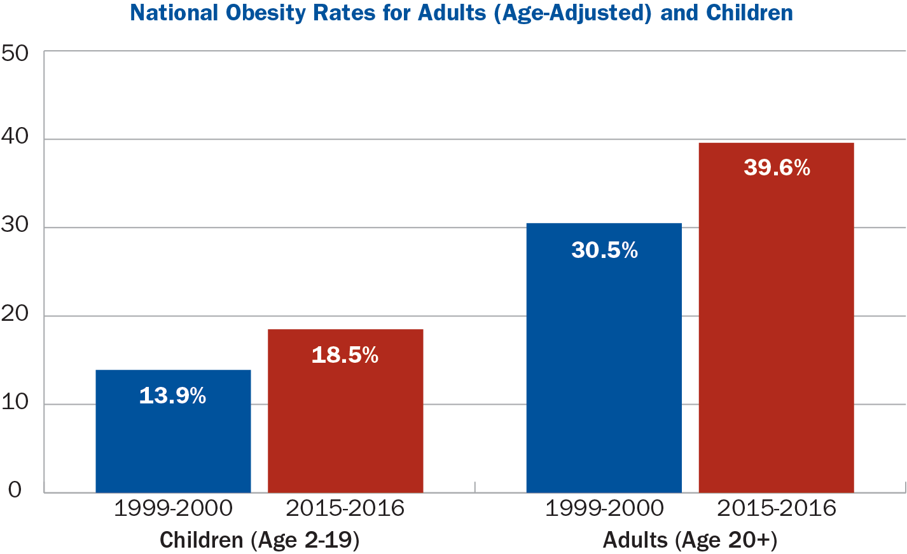

Slide 7
The Healthy Communities Study found that children living in localities that did more to encourage physical activity and healthy nutrition had lower body mass index and waist circumference measures

Slide 8
According to a report from the Centers for Disease Control, 39.8% of adults and 20.6% of adolescents in the United States are obese. Among children ages 6 to 11, 18.4% are obese, while among children ages 2 to 5, the percentage is 13.9%.
The rate of obesity in adolescents increased by 33% from 2000 to 2016 and by approximately 30% in adults. The greatest percentage of obese people (42.8%) is recorded in middle-aged people (40-59 years old) and affects more African Americans and Latin Americans than Caucasians and Asians.

Slide 9
These are the highest rates ever recorded in the U.S. “It’s difficult to be optimistic at this point,” said Dr. Frank Hu, chair of the Department of Nutrition at the Harvard School of Public Health. “The trend of obesity has been steadily increasing in both children and adults despite many public health efforts to improve nutrition and physical activity.”
From 2000 to 2016, the rate of obesity in adults over 20 years of age went from 30.5% to 39.8%, while in the age range of 1 to 19 years old, it went from 13.9% to 18.5%. In total, approximately 70% of Americans are obese or overweight. There was no significant difference recorded between males and females in any age group.

Slide 11
The Green Fit is rooted in contextualizing products that make up the so-called “basket of the Mediterranean diet” and, first among these, the product of olive oil, at this very moment in history for the United States of America when obesity is increasingly topping the list of alerts from the American health department.
The goal of The Green Fit is to sensitize, educate and train about the real necessity to adopt a green line for a good life!

Slide 12
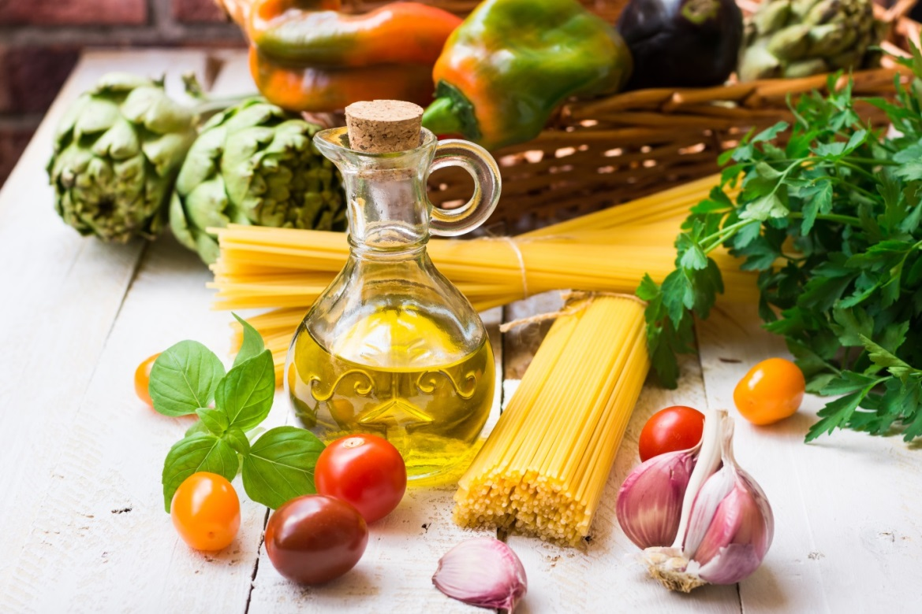


Slide 13
The Green Fit is a learning format, conceived and created by
GP Communications North America Inc.
and produced by
Filippo Berio

Slide 14
The Learning Format includes:
Cooking Shows
Seminars
Meetings with the press, buyers, stakeholders and institutions
it will be on a dedicated portal www.thegreenfit.com
Newsletter
a dedicated social channel
INSTAGRAM - YOUTUBE

Slide 15


Slide 16
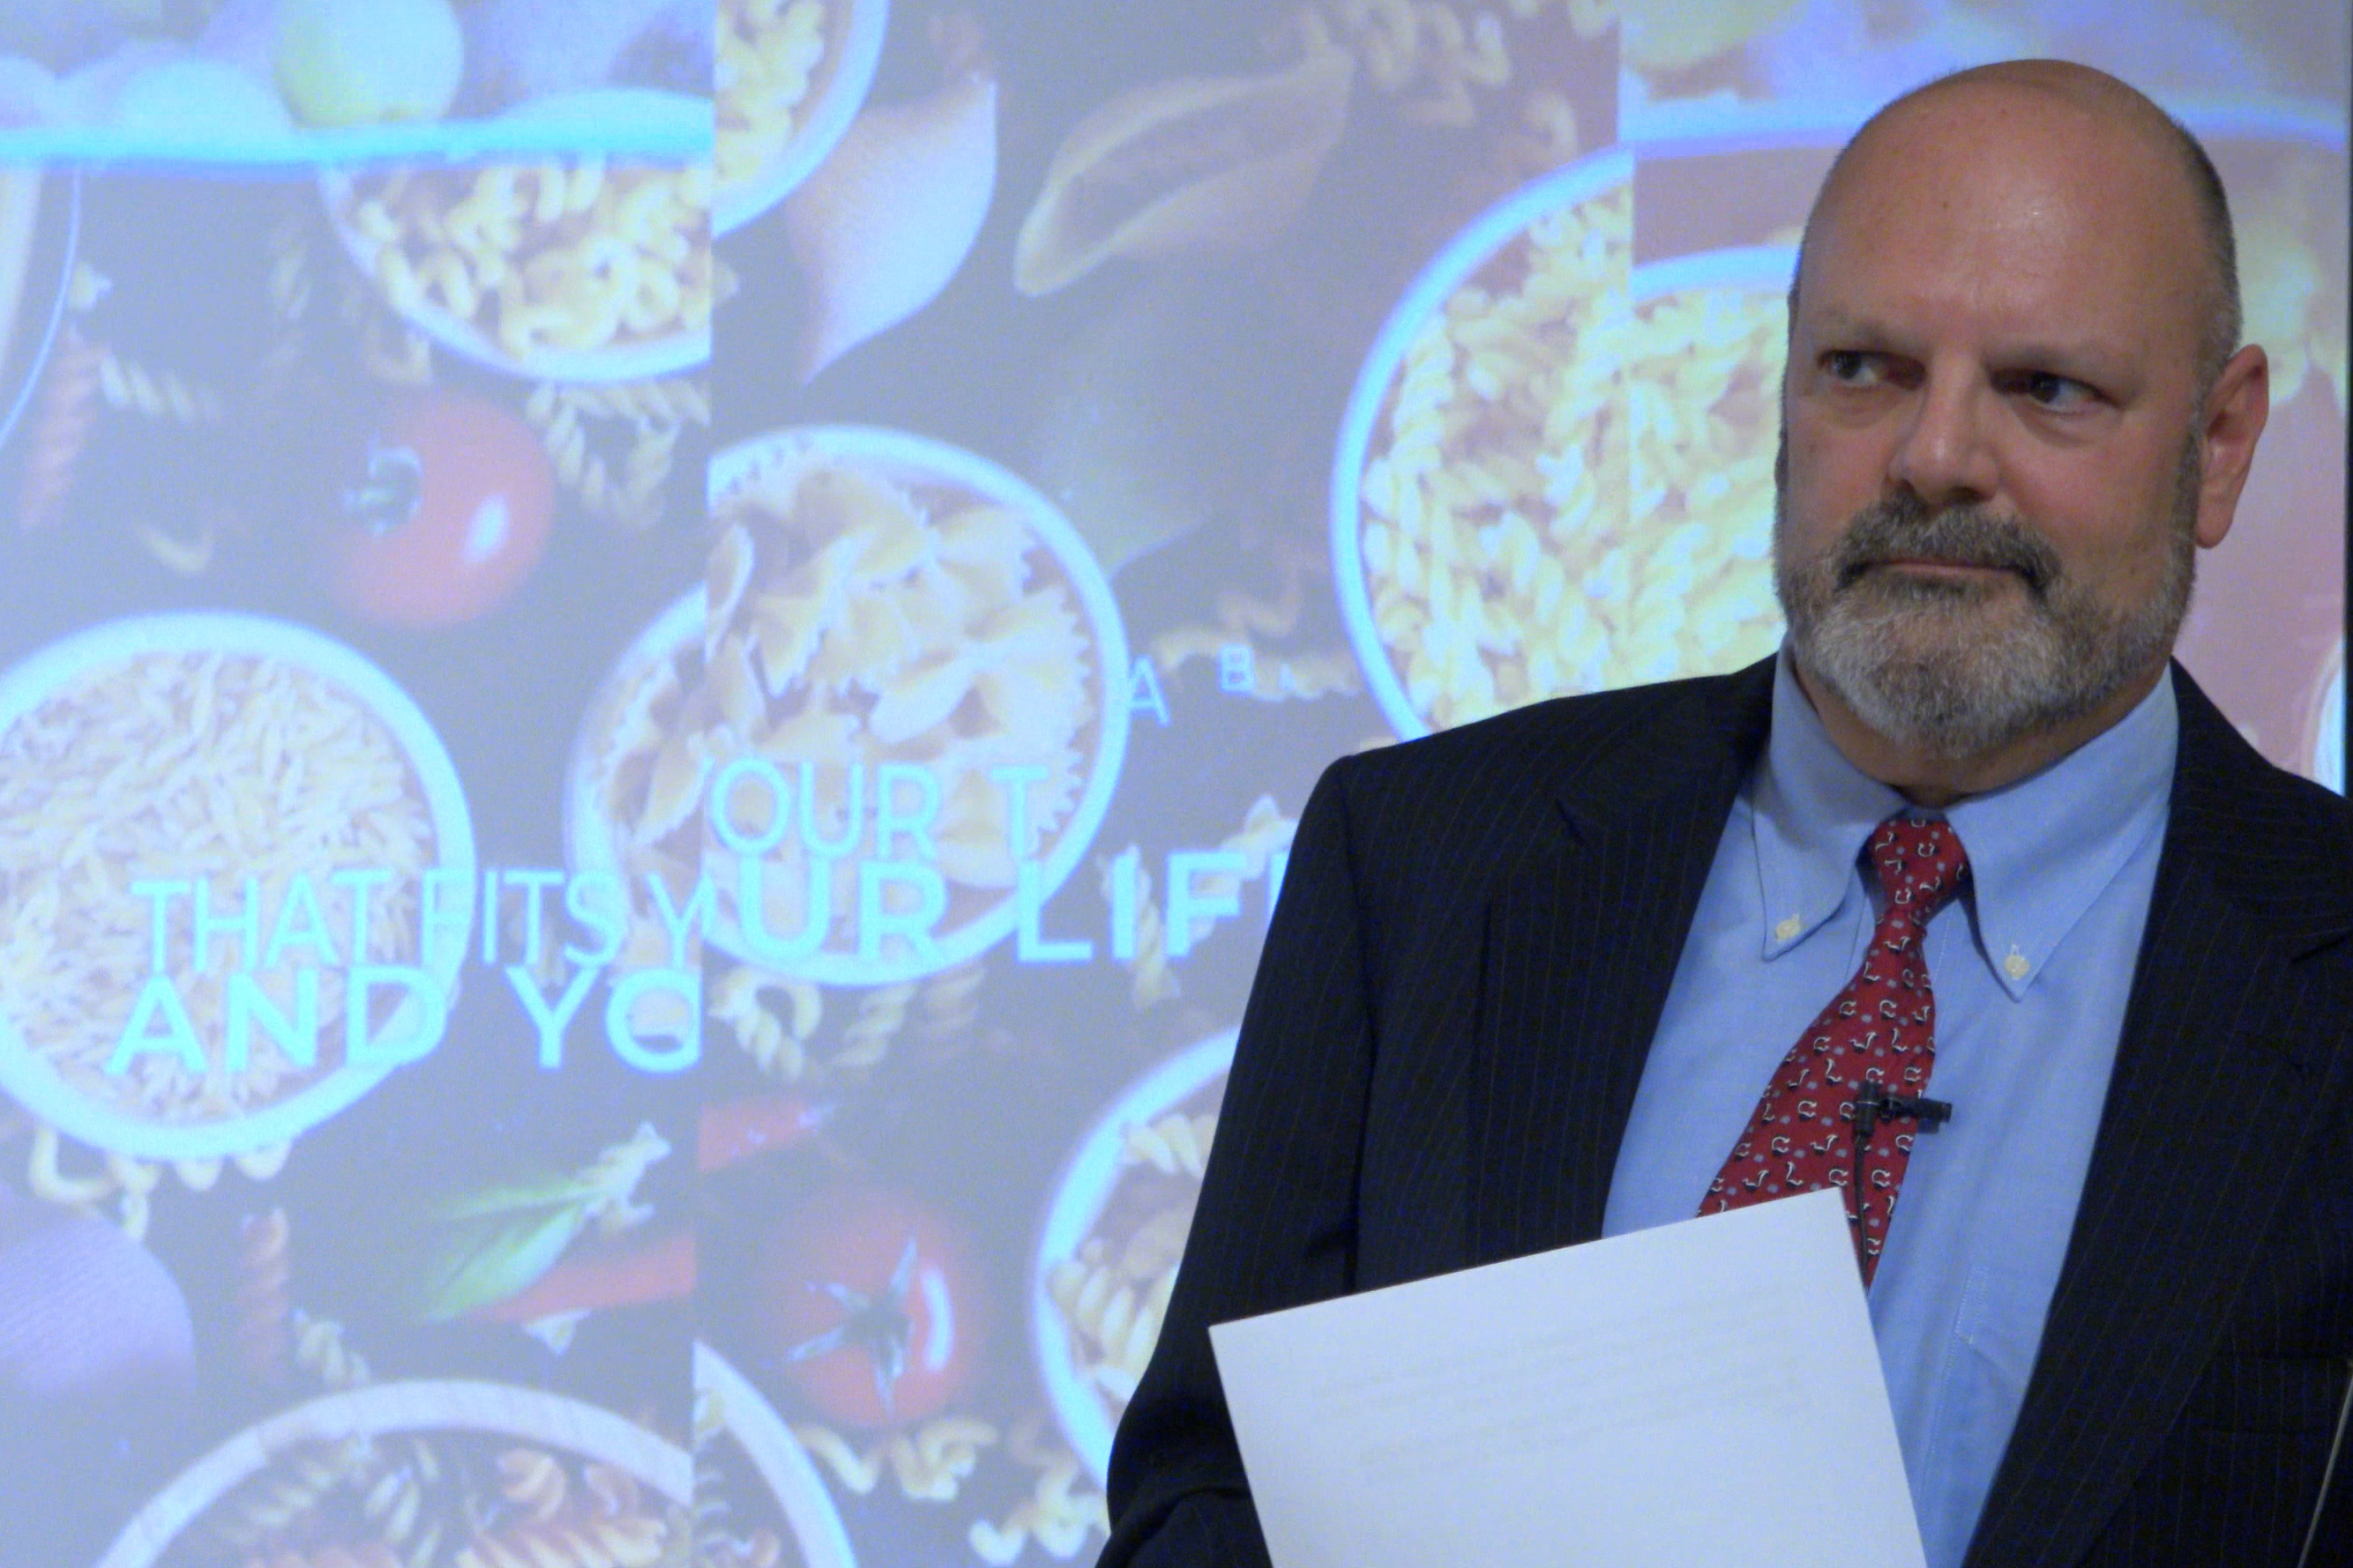
Filippo Berio North America CEO Marco de Ceglie
Is the project coordinator

Slide 17
Scavolini will be involved in the cooking shows: the first two events will take place in September in Soho, New York, and in November in Orange County, California
The headliners of the cooking shows will be:
Berio olive oil and Berio products, Scavolini kitchens, products from the Mediterranean
diet cooked by Chef Andrea Zanin and discussed by Lucrezia Scarampi nutritionist.
The cooking shows’ guests will be journalists, bloggers, opinion leaders, opinion makers, stakeholders and buyers
Everything will be filmed on camera so it can be enjoyed again on both the website and Instagram.

Slide 18
EVENT

Slide 19

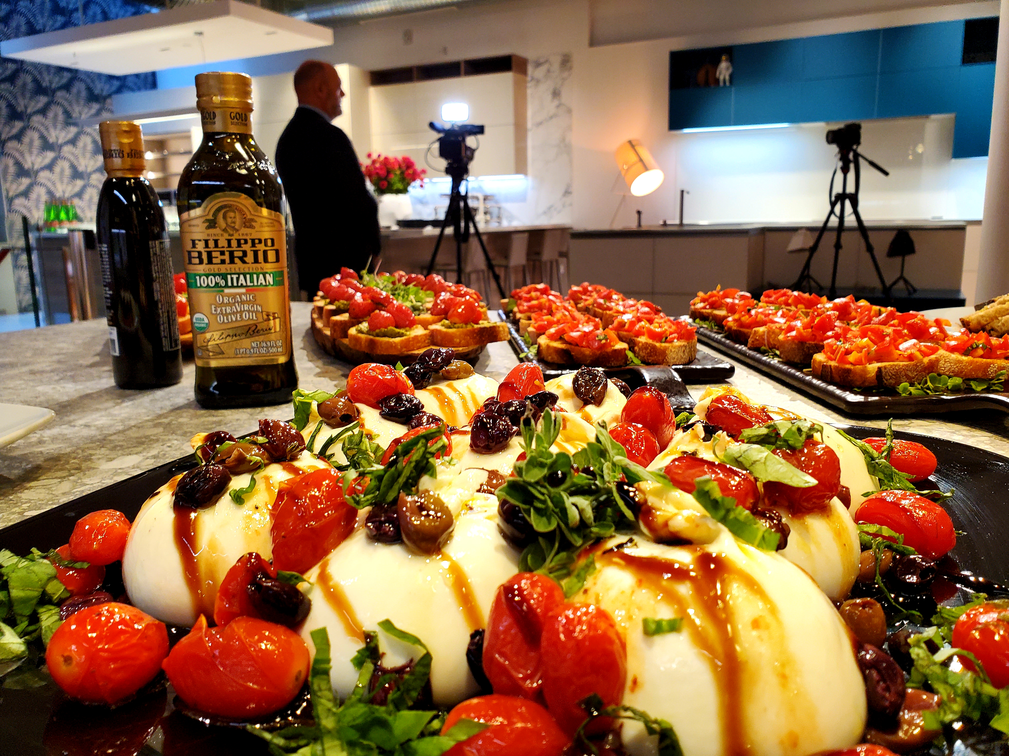
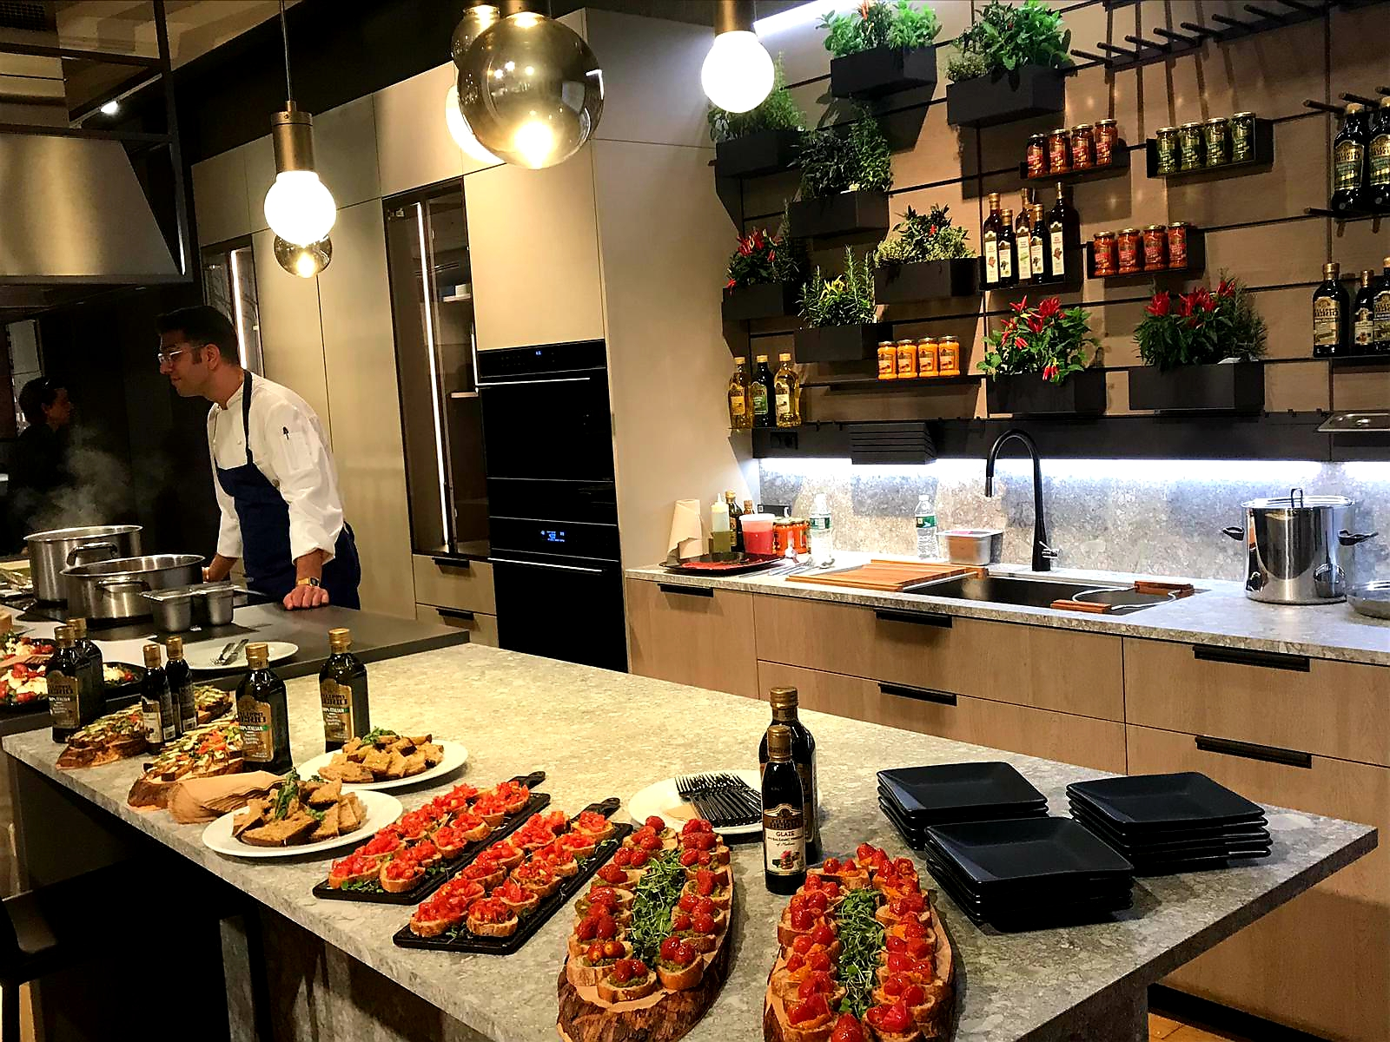
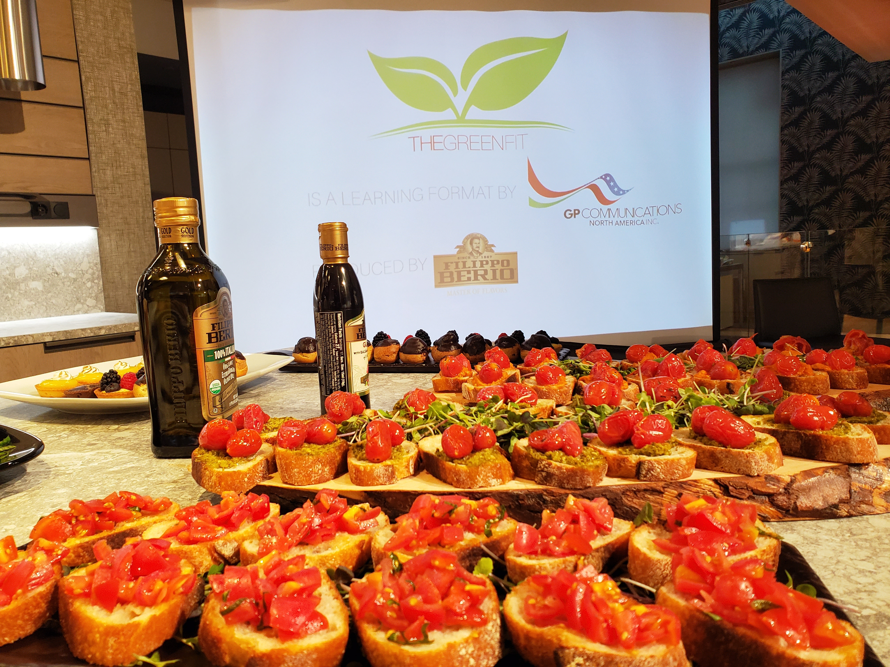
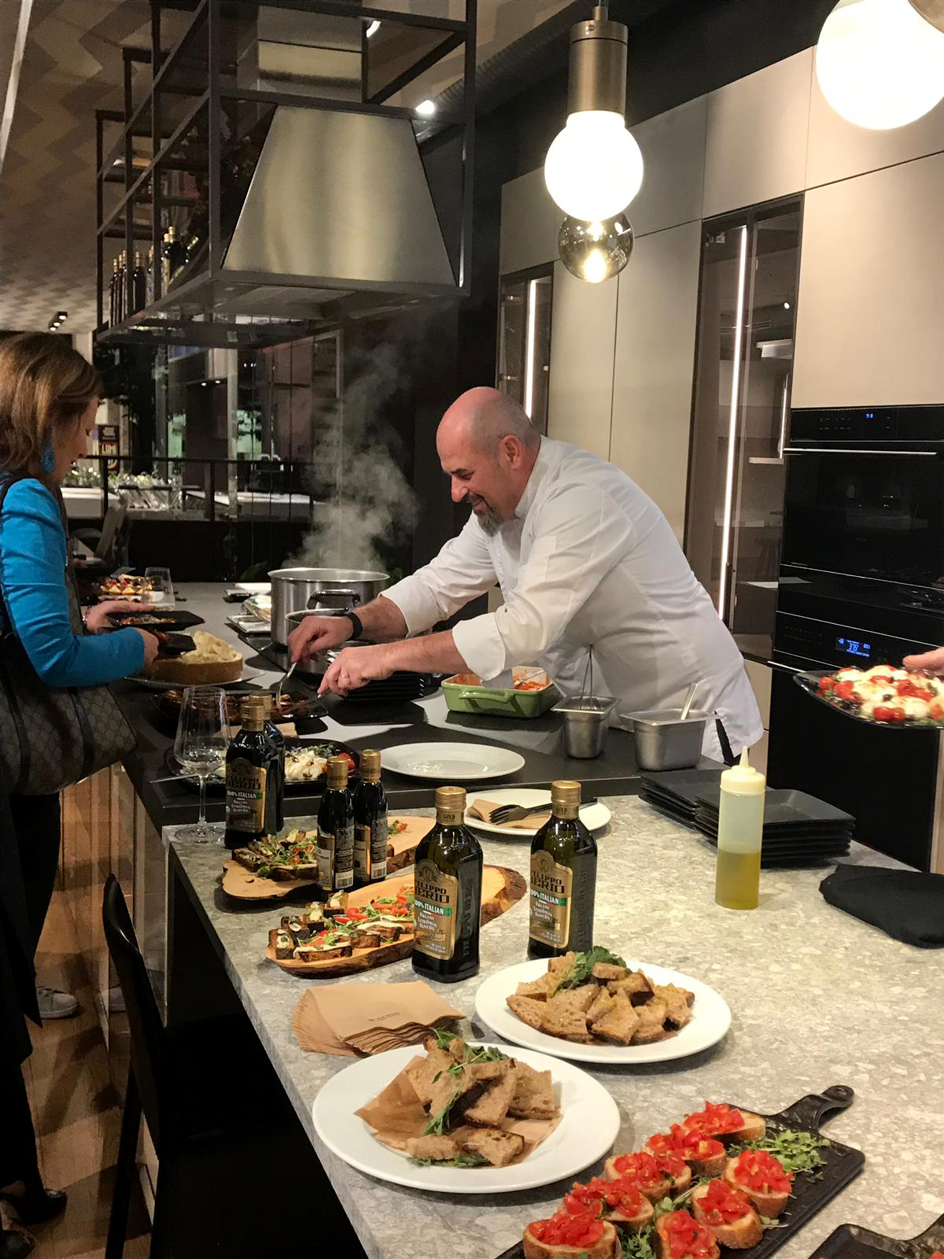
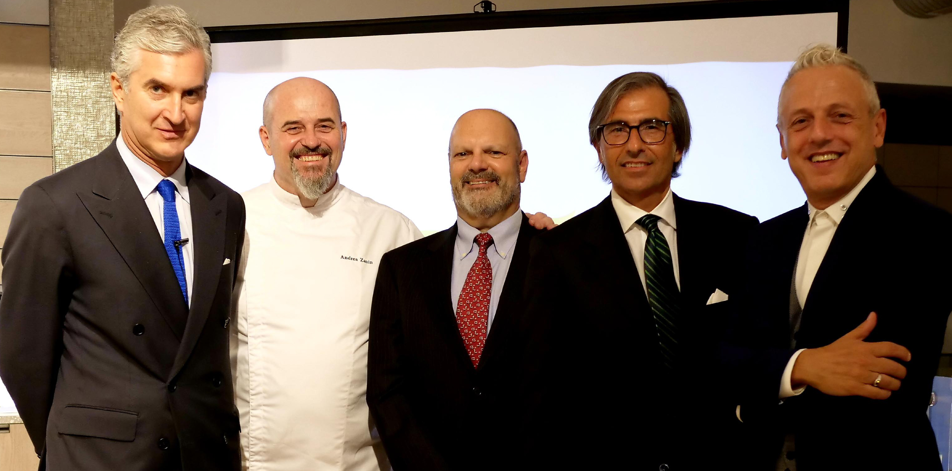
EVENT

Slide 20
EVENT

Slide 21




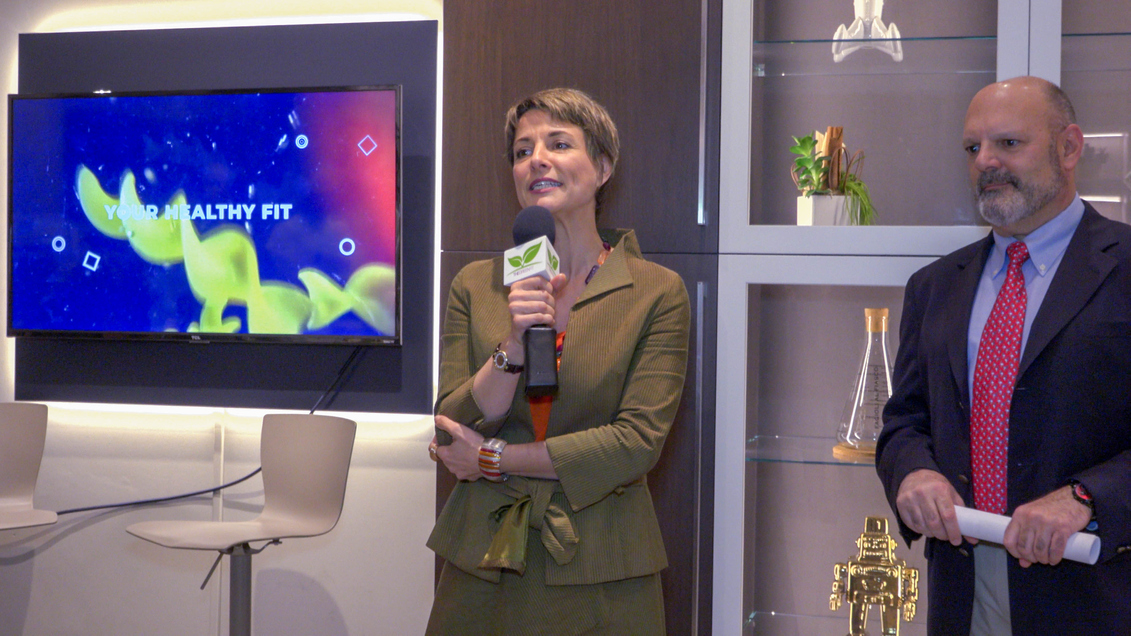
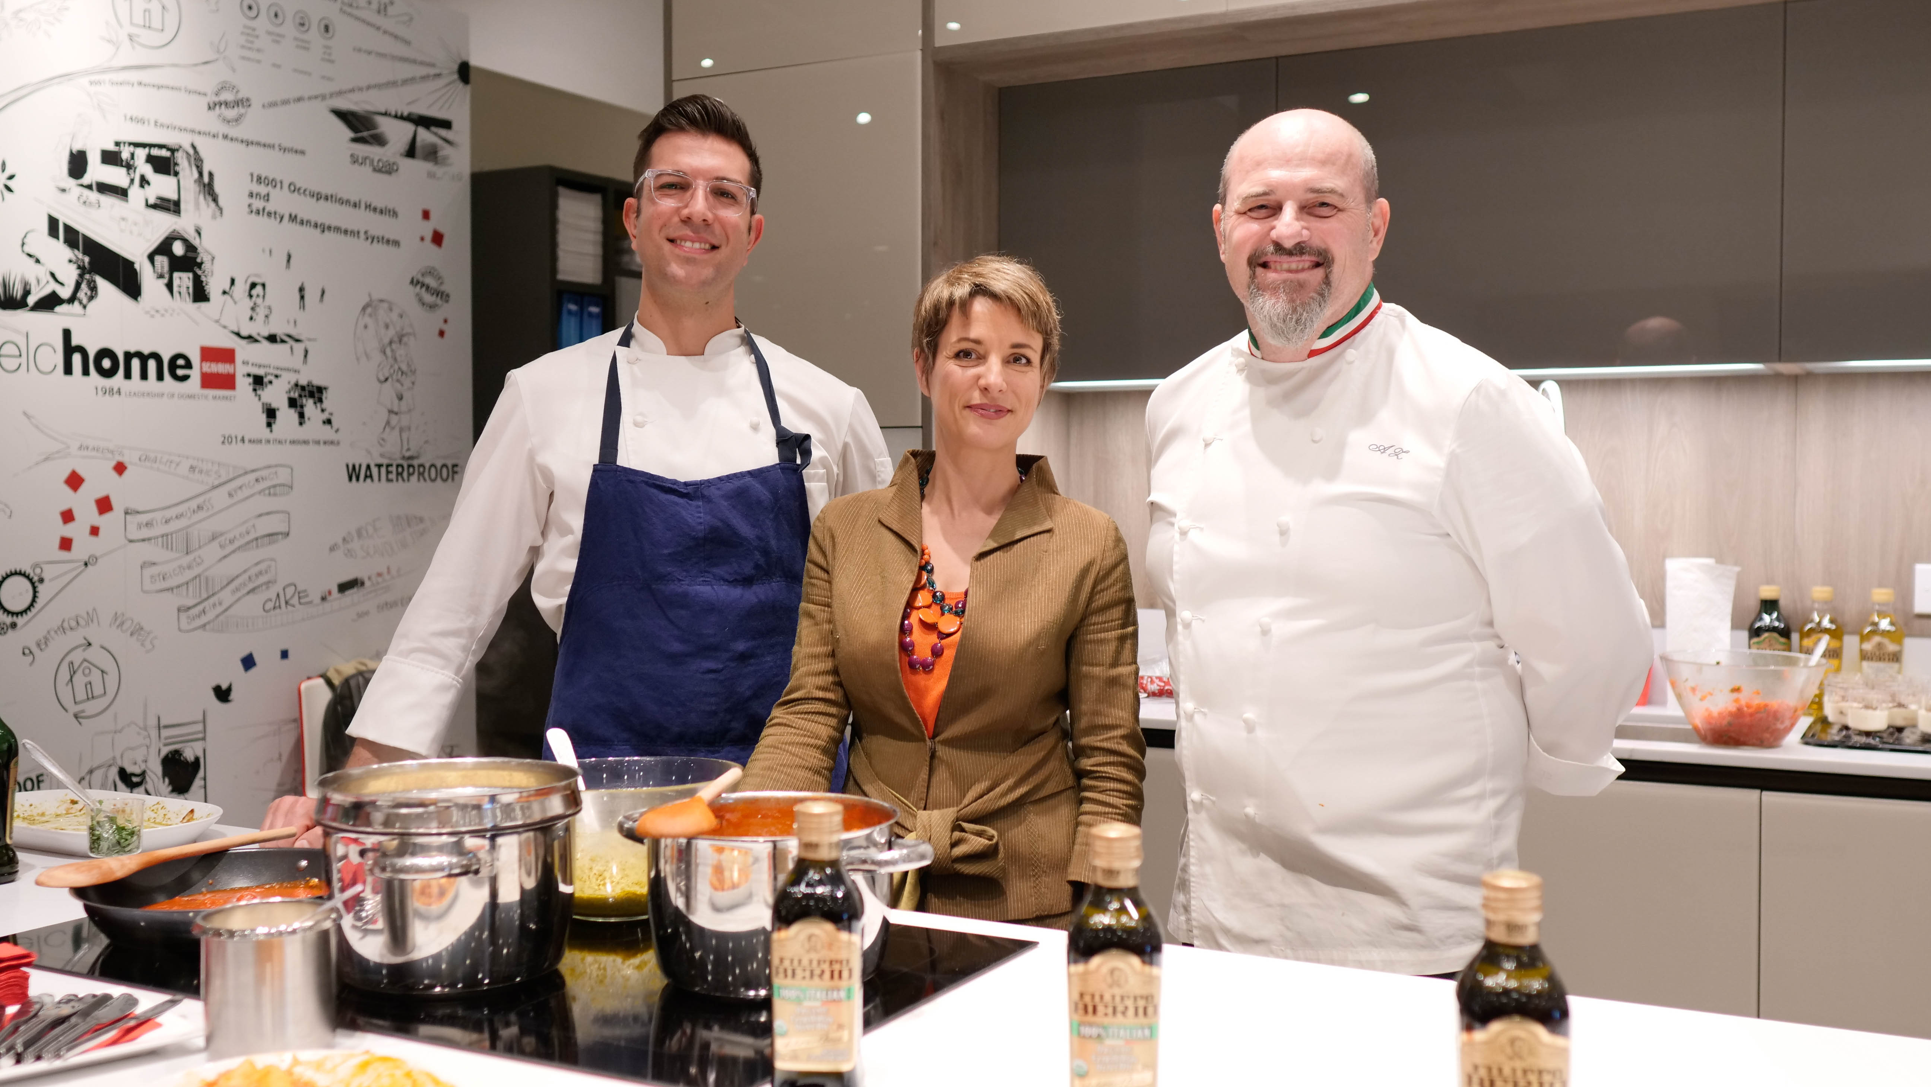

EVENT

Slide 22


THE PLAYERS
with the patronage of

